Slide 1

Intermediate Code Generation
Baivab Das
Lecturer
Department of CSE
University of Asia Pacific

Slide 2
Introduction
IC is the representation between the source language and the target machine language programs
It offers several advantages:
Closer to target machine, so it is easier to generate the target code
More or less machine independent, makes it easier to re-targate the compiler to various different target processors
Allows variety of machine-independent optimizations
Phases till the Intermediate code is same for all the processors, the target code generator and code optimizer will depend on the processors

Slide 3
Intermediate Languages
IC can be classified into two types:
High-Level Representation
Low-Level Representation
Closer to source language program
Easy to generate from input program
Code optimization is difficult as input program is not broken down sufficiently
Closer to traget machine
Easy to generate final code
Needs much effort to generate from the source code

Slide 4
High-Level Representation
Abstract Syntax Trees
Directed Acyclic Graphs
P-Code

Slide 5
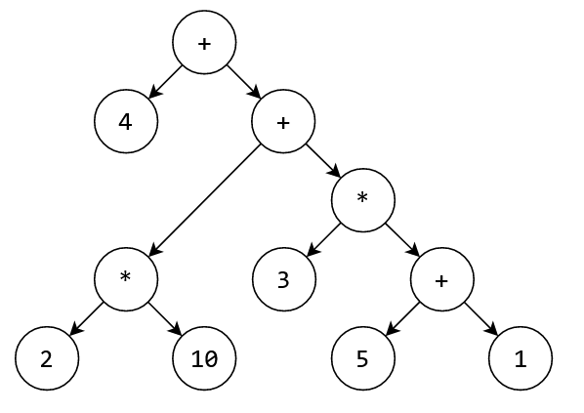
Abstract Syntax Trees
Compact form of parse tree
Represented hierarchical structure of a program
Nodes represent operators, children of a node represents the operands
Example: “4 + 2 * 10 + 3 * (5 + 1) ”

Slide 6
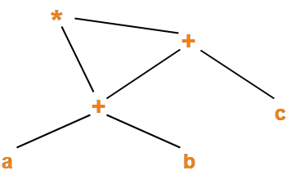
Directed Acyclic Graphs (DAG)
A directed acyclic graph (DAG) refers to a directed graph which has no directed cycles.
For tree, every node has a unique parent node. If a node has two parents, then it is called a graph.
Example: ( a + b ) x ( a + b + c )
Mainly, we generate DAG from TAC

Slide 7
P-Code (Portable Code)
Used for stack based Virtual machines
It is an assembly language for a hypothetical machine
Operands are always found on the top of the stack
May need to push operands to the stack first
Example of this is bytecode
The name bytecode stems from instruction sets, which have one byte opcodes, followed by optional parameters
Java uses bytecode

Slide 8
Low-Level Representation- TAC
Sequence of instructions of the form
x = y op x
Only one operator is permitted in the right-hand side
Due to its simplicity, it offers better flexibility in terms of target code generation and code optimization
Most of the processors supports this three-address format
t1 = y * z
t2 = w * a
x = t1 + t2
x = y * z + w * a

Slide 9
Statements in TAC
Statements in intermediate languages which uses TAC are:
Assignment
Jumps
Address and Pointer Assignments
Procedure Call/Return
Miscellaneous

Slide 10
Assignment Statements
There are three types of assignment statements:
x = y op z, op being a binary operator
Example: x = y and z
x = y op z, op being a unary operator
Example: x = y not z
x = y
no operation or copy operation, just the value of y is assigned to x
For all operators in the source language, there should be a counterpart in the intermediate language. Otherwise, there will be no easy code generation.
Complex source language operator should be converted into easier ones

Slide 11
Jump Statement
Both condition and unconditional jumps are required
Goto L, L being a label (L is again hypothetical)
goto L1
goto L2
If x relop y goto L
if this statement is here, no separate if then else statement is required
if x>y goto L1

Slide 12
Indexed Assignment
It also supports array type structures as array are too common
Multi dimension arrays are converted into one-dimensional array
x = y[i]
x[i] = y
Example:
a[i] = b[j]
t = b[j]
a[i] = t

Slide 13
Address and Pointer Assignments
Statements required are of following types:
x = &y, address of y assigned to x
x =*y, content of location pointed to by y is assigned to x
X = y, simple pointer assignment, where x and y are pointer variables

Slide 14
Procedure Call/Return
A call to the procedure P(x1, x2, ……., xn) is converted as:
param x1
Param x2
….
param xn
In runtime environment management, we create activation records. The activation record will use these parameters
A procedure is implemented by using the following statements:
enter f, setup and initialization
leave f, Cleanup actions (if any)
return
return x
retrieve x, Save returned value in x
f1(a1,a2)
f1
Param a1
Param a2
Enter f1
Retrieve t1
x = t1
<local_part>
…..
….
…..
return
Leave f1

Slide 15
Miscellaneous Statements
Depending upon the source language, more statement might be needed
Suppose, in C we have next or break or continue which may not be present in some other language
This can be done by goto statement

Slide 16
TAC Instruction Implementation
Quadruples
Triples
Indirect Triples

Slide 17
Quadruples
Each record have four fields: operator, arg1, agr2, result
x = y op z (op is operator, y is arg1, z is arg2 and x is result)
x = op y (unary statement, no arg2)
x = y (assignment/copy statement, no arg2)
param x (no arg2 and result)
goto L (L is result)
if x relop y goto L (L is result)

Slide 18
a = b * -c + b * -c
t1 = uminus c
t2 = b * t1
t3 = uminus c
t4 = b * t3
t5 = t2 + t4
a =t5
Quadruple Structure
 | op | arg1 | arg2 | result
(0) | uminus | c |  | t1
(1) | * | b | t1 | t2
(2) | uminus | c |  | t3
(3) | * | b | t3 | t4
(4) | + | t2 | t4 | t5
(5) | = | t5 |  | a
In quadruple arg1, arg2 and result are pointers to the symbol table entry
(uminus = uniary minus)

Slide 19
Triples
Quadruple Structure
 | op | arg1 | arg2 | result
(0) | uminus | c |  | t1
(1) | * | b | t1 | t2
(2) | uminus | c |  | t3
(3) | * | b | t3 | t4
(4) | + | t2 | t4 | t5
(5) | = | t5 |  | a
To avoid entering temporary variables in the symbol table, we use triples
Triples has three fields: operator, arg1, arg2
Instead of using the temporary variables, we use the location
Triple Structure
 | op | arg1 | arg2
(0) | uminus | c
(1) | * | b | (0)
(2) | uminus | c
(3) | * | b | (2)
(4) | + | (1) | (3)
(5) | = | a | (4)
a = b * -c + b * -c
t1 = uminus c
t2 = b * t1
t3 = uminus c
t4 = b * t3
t5 = t2 + t4
a =t5

Slide 20
Indirect Triples
Indirect triples has pointers to triple structure
In optimizing compilers statements will be moved from one place to another place (statement reordering).
So, in quadruples, statement reordering will preformed easily with any change but in triple, we need to change the locations
Indirect Triple Structure
(i) | (0)
(ii) | (1)
(iii) | (2)
(iv) | (3)
(v) | (4)
(vi) | (5)
Triple Structure
 | op | arg1 | arg2
(0) | uminus | c
(1) | * | b | (0)
(2) | uminus | c
(3) | * | b | (2)
(4) | + | (1) | (3)
(5) | = | a | (4)
If we compare quadruple with triple, quadruple is better
But, if we compare quadruple with indirect triple, in indirect triple statement reordering can be done
Common expressions can also be removed

Slide 21
Quadruple Structure
 | op | arg1 | arg2 | result
(0) | uminus | c |  | t1
(1) | * | b | t1 | t2
(2) | uminus | c |  | t3
(3) | * | b | t3 | t4
(4) | + | t2 | t4 | t5
(5) | = | t5 |  | a
Advantage: Statements can be moved around Disadvantage: Too much of space is wasted
Triple Structure
 | op | arg1 | arg2
(0) | uminus | c
(1) | * | b | (0)
(2) | uminus | c
(3) | * | b | (2)
(4) | + | (1) | (3)
(5) | = | a | (4)
Advantage: Space is not wasted Disadvantage: Statements cannot be moved
Indirect Triple Structure
(i) | (40)
(ii) | (41)
(iii) | (42)
(iv) | (43)
(v) | (44)
(vi) | (45)
Advantage: Statements can be moved Disadvantage: Two memory access
Statements can be moved means the statements are independent. Suppose, if the value of an expression is still missing, we can move the next instruction up if the expressions are not interdependent !

